Slide 1


JPA for NoSQL
SERGEY CHERNOLYAS
MAY 27, 2017

Slide 2

Sergei CHERNOLYAS
Lead Software Engineer
15+ лет в разработке на Java;
6 сертификатов (4 – по Java технологиям и 2 – SOA);
Участие в нескольких крупных проектах.
Участие в OpenSource проектах в 2016 года

Slide 3
Agenda
JPA for NoSQL: как и зачем?;
Презентация проекта Hibernate OGM;
Презентация СУБД «OrientDB»
Прентация модуля Hibernate OGM for OrientDB
Заключение.

Slide 4
JPA for NoSQL: Как и зачем?
Стандартный путь описания доменной модели
Общий способ для работы с сущностями
Единый способ для работы с несколькими хранилищами
Notes:
One of first implementations of ORM (Object-Relation-Mapping) was Entity Beans from EJB2 (specification 1.1 from 1999). So, You can see that idea of ORM for relational databases is old enough. But … What is reasons of it? Everyone knows that relational databases has standard language (SQL) and standard interface for database driver (JDBC). However, ORM tools as middle level have been progressing.
Why?
I think that main reasons are :
Firstly, ORM provides a general way for describe domain model. And secondly, ORM takes care of working with database.
JPA as the inheritor of ORM ideas is the most used standard since 2006 (JPA 1.0) . The current version of the specification is 2.1. Now, JPA has several implementations such as Hibernate ORM, EclipseLink and Apache OpenJPA, these implementations have had production status for many years.
So, everything is okey in world of relational databases.
But what about the world of NoSQL storages? Can we use the same ways with NoSQL storages? Can we use the same application with MongoDB and Apache Casandra?

Slide 5

Презентация проекта «Hibernate OGM»

Slide 6
Презентация проекта
Цели проекта
Достижения проекта
Notes:
The project “Hibernate OGM” started in 2011.
Its main goal is to provide one standard access for all NoSQL storages. Its target specification is JPA 2.1
Now, achievements of the project are :
supporting the most of used types of storages
supporting the eight most popular storages
implementing the most of requirements of JPA 2.1 specification

Slide 7
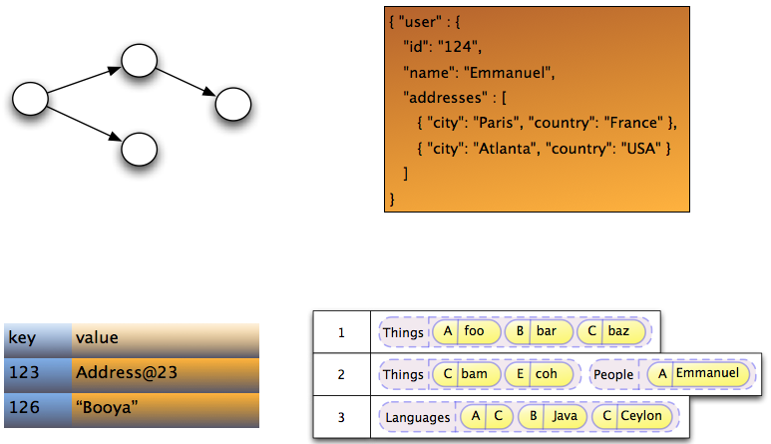
Поддержаные типы хранилищ
Notes:
You see the image from project documentation. It demonstrates that the world of NoSQL has many kinds of storing.

Slide 8
Поддержаные типы хранилищ
Граф-ориентированные
Документ-ориентированные
Колонко-ориентированные
Key-value
Мульти-модельные (появится в версии 5.2)
Notes:
You see the image from project documentation. It demonstrates that the world of NoSQL has many kinds of storing.

Slide 9
Поддержаные хранилища
Neo4j
MongoDB, CouchDB(Experimental)
Cassandra(experimental)
Infispinian, Ehcache, Redis(Experimental), Apache Ignite (включено в релиз 5.2)
OrientDB (включено в релиз 5.2)
Notes:
This slide contains the enumeration of supported storages. The storages selected by italic is included to release 5.2 plan.
A part of storages has status “experimental”.

Slide 10
Поддержаные функции
Хранилище | Характеристики
 | Ассоциа-ции | Запросы | Транзакции | Режим работы
Mongodb | + | Native, JPQL | Emulation | Remote
CouchDB | + | Native | Emulation | Remote
Infispinian | + | JPQL | JTA | Remote/Embedded
Ehcache | + | - | - | Remote
Redis | + | JPQL | Emulation | Remote
Neo4j | + | Native, JPQL | Emulation | Remote/Embedded
Cassandra | + | Native, JPQL | Emulation | Remote
Notes:
This slide contains aggregated information about features for each storage.
Look at the column Assiations. All integration modules supports all types of associations in JPA 2.1 It “One-To-One”, “Many-To-Many” and so on.
Look at the column Queries. A part of storages supports JPQL. The feature is implemented by Hibernate Search product.
Look at the column Transactions. The most of storages support transactions by emulation. A part of them has its own transaction system. And Hibernate OGM integrates transaction system of storage with the standard transaction system (JTA). Other part of storages has not any transactions. In this case, Hibernate OGM emulates the transaction by side tools.
Look at the column Remote / Embedded. A part of integration modules supports embedded mode. For example, Neo4j.

Slide 11
Архитектура проекта
em.getTransaction().begin();
em.persist(new Person("name1"));
em.getTransaction().commit();
Hibernate ORM Core
Hibernate OGM Core
4.commit()
3.insertTuple()
2.createTuple()
1.begin()
Hibernate OGM Module for Concrete Storage
GridDialect
DatastorageProvider
Notes:
It’s time to talk about architecture. Project Hibernate OGM (Object-Grid Mapping) is based on famous Hibernate ORM (Object-Relational Mapping).
What happens when we execute the simple code?
The core of Hibernate ORM defines type of request and redirects the request to core of Hibernate OGM. Then, the core of Hibernate OGM loads concrete provider and sends it a sequence of commands of a lower level. These commands are:
To create a new transaction
To create an empty tuple for future entity
To set data of new entity and to insert to storage
To commit the transaction.
Then concrete data storage provider and grid dialect do low-level actions with the storage.
The demonstrated sequence is right for OrientDB integration module. Integration modules for other storages can have another sequence.

Slide 12

Презентация СУБД «OrientDB» presentation

Slide 13
Преимущества OrientDB
Разработана на Java
Мульти-модельная (граф- и документ- ориентированная)
SQL-подобный язык запросов
Поддерждка хранимых процедур на разных языках (JSR-223)
Репликация «мастер-мастер»
Возможность делать запросы к частям таблицы (индекс, кластер, RID)
Хорошая производительность ( 10x быстрее чем Neo4j )
Join-less подгрузка зависимостей
API для нескольких языков
Поддерка транзакций (собственная реализация)
Notes:
OrientDB is a multi-model database. It combines document-oriented and graph storages. In this way, you can create a document as graph node (vertex) and you can make link (edge) to other graph node. The first release of OrientDB was in 2010 by Luca Garulli.
OrientDB has advantages

Slide 14
Недостатки OrientDB
Маленькая команда и community
Реализация еще «зеленая» (текущая разрабатываемая версия 3.0.0-SNAPSHOT)
Notes:
OrientDB is a multi-model database. It combines document-oriented and graph storages. In this way, you can create a document as graph node (vertex) and you can make link (edge) to other graph node. The first release of OrientDB was in 2010 by Luca Garulli.
OrientDB has advantages

Slide 15
Презентация интеграционного модуля Hibernate OGM for OrientDB

Slide 16
Реализованно в первом релизе
Работа со встроенной и удаленной СУБД
Поддержка документо-ориентированной модели
Поддержка всех типов ассоциаций (one-to-one, one-to-many, many-to-many, embedded)
Notes:
OrientDB is a multi-model database. It combines document-oriented and graph storages. In this way, you can create a document as graph node (vertex) and you can make link (edge) to other graph node. The first release of OrientDB was in 2010 by Luca Garulli.
OrientDB has advantages

Slide 17
Планы на следующие релизы
Использование RID в качестве первичного ключа
Поддержка графовой модели связей
Notes:
OrientDB is a multi-model database. It combines document-oriented and graph storages. In this way, you can create a document as graph node (vertex) and you can make link (edge) to other graph node. The first release of OrientDB was in 2010 by Luca Garulli.
OrientDB has advantages

Slide 18


